Slide 1
Chapter 4 Objectives
The CCNA Topics Covered in this chapter include:
  What are named ACLs?
  Configuration
  How to restrict telnet access
  Rules of ACLs

Slide 2
Named ACLs
IP named ACLs allow standard and extended ACLs to be given names instead of numbers.
The characteristics of named access-list:
  Identify an ACL using an alphanumeric name.
  You can delete individual statements in a named access list
  Named access lists must be specified as standard or extended
  You can use the ip access-list command to create named access lists.
  The same name may not be used for multiple ACLs.

Slide 3
Named ACL’s
Numbered Access list did not give you any hint, What is filtered
Named ACL’s are both basic and advanced filtering tool
Name cannot start with a number or !
Cannot have space in the name
Should not have ? Character anywhere in the name
Name is case sensitive

Slide 4
Named ACL Example
R1(config)#ip access-list standard blocksales
R1(config-std-nacl)#deny 172.16.40.0 0.0.0.255
R1(config-std-nacl)#permit any
R1(config-std-nacl)#exit
R1(config)#^Z
R1#
#int e 0
#ip access-group blocksales out

Slide 5
How to control vty access to a router
We can apply access list to a router indicating who can telnet to a particular router. This is a powerful feature because our routers may be plugged into a public network. We do not want Everybody to be able to telnet to this router.
R(config)# line vty {vty# | vty-range}
R(config-line)# access-class acl# {in | out}
R(config)# access-list 12 permit 192.168.1.0 0.0.0.255 (implict deny all)
R(config)# line vty 0 4
R(config-line)# access-class 12 in
Permit anybody in the subnet 192.168.1.0 to telnet to router
To restrict telnet to the router use “in” and If you put outbound direction
that means that from this router, u can’t really telnet to certain IP addresses.

Slide 6
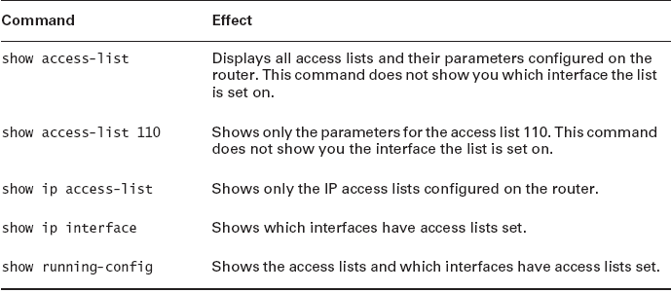
Verify Access List

Slide 7
Basic Rules for ACLs
  Standard IP access lists should be applied closest to the destination.
  Extended IP access lists should be applied closest to the source.
  Use the inbound or outbound interface reference as if looking at the port from inside the router.
  Statements are processed sequentially from the top of list to the bottom until a match is found, if no match is found then the packet is denied.
  There is an implicit deny at the end of all access lists. This will not appear in the configuration listing.
  Never work with an access list that is actively applied.
  Create access lists before applying them to interfaces.
  A no access-list x command will remove the whole list. It is not possible to selectively add and remove lines with numbered ACLs.
  Outbound filters do not affect traffic originating from the local router.

